Slide 1

British Airways
Web scraping to gain company insights
Lachiket Warule
03/19/2025

Slide 2
INSIGHTS FROM CUSTOMER REVIEWS
From cleaning data of 1000 reviews given by the customers, we obtained
Positive Reviews - 451
Negative Reviews - 443
Neutral Reviews – 106

Slide 3
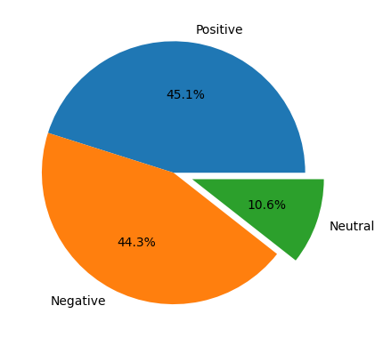
Pie chart

Slide 4
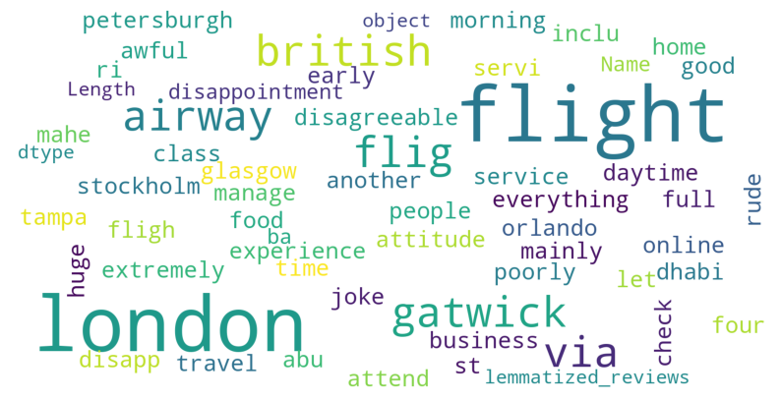
Word Cloud

